Slide 1

Customer Retention Project

Slide 2
INTRODUCTION
This is a case study on Indian E-commerece customers to know which are the major factor for activation and retention of the customers, Customer satisfaction has emerged as one of the most important factors that guarantee the success of online store
Activation/Retention
For this project a detailed research has been conducted to increase the purchase ,actiivation and retention of customers.
Five major factors
Service quality, System quality, Information quality,trust and net benifits are the key factors.
Loyalty
The combination of both utiliterian and hedonestic values are need to affect the repeat purchase(loyalty)

Slide 3
Project Flow
1
Basic outlook over the project
This slide talk about the aim of the project,Informations to be drawn for better conclusions etc
2
Processing of data
This slide talk about preprocessing of the data
3
Univariate Analysis
This slide talk about the analysis of independent variables
4
Bi variate Analysis
This slide talk about the relationship between two variables.
5
Multivariate Analysis
Here we are going to look the relationship between more than 2 variable
6
Conclusion
This final slide talk about the summary of the inforamtion drawn from the analysis

Slide 4
Basic outlook over the data
Regarding dataset
This is a wide dataset consisting of 269 rows and 71 categorical columns without any missing values.
How data is there?
The first 19 columns are about the users and their stereotyping regarding the online retail-e-commerece retail shop.
Last 20 columns infers which is users favorite Indian online retail shop on different intrest like several payment options,appealing web pages,offer etc.
The rest of the column columns belongs to users rating the online retail shop as general on different questions.

Slide 5


Preprocessing of Data
Categorical columns
Since all the columns are of categorical type we did the label encoding, There were no null values, In some cases column name was out of simplicity so we renamed it for future analysis purpose
Dictionary
We made seperate dictionary for each columns to keep which label encoded value infers what.

Slide 6
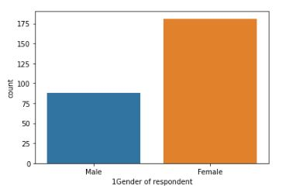
Exploratory Data Analysis
Since the dimension of the dataset is significantly wide there was lump sum amount of data in different angles , We picked up relevent information through 3 types of following analysis.
UnivariateData Analysis
In this case we analyse only one variable at a time, there is detailed information in the project report , Here we are going through important features only.
In this particular dataset around 67% of users are females and left 33% are male

Slide 7
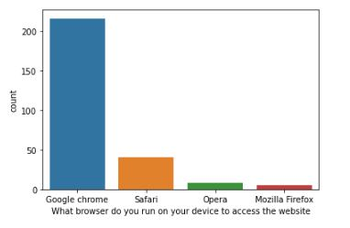
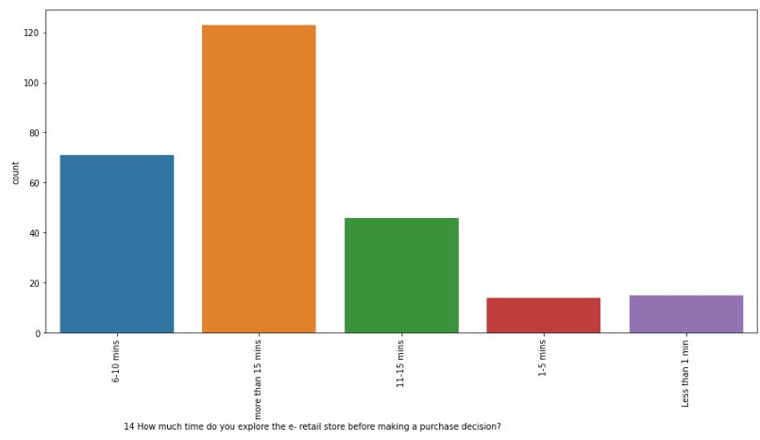
Around 80% of user use Google Chrome as their web browser followed by safari,opera and Mozilla firefox of 15%, 3% and 2% respectively.
How much time do you explore the e-retail store before making an decision
Around 44% of user spend more than 15 min before they make up the decision of purchasing .
Around 24% of user spend 6-10 minutes before making an decision of purchasing
Around 19% of user spend 10-15 minutes before making an decision of purchasing

Slide 8
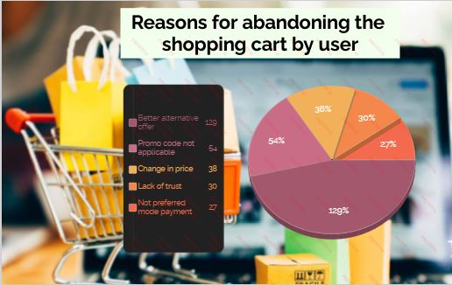
How frequently do you abandon (selecting an items and leaving without making payment) your shopping cart?
Around 63% of user abandoned sometimes without making an payment
Around 18% of user never abandoned without making an payment
Around 13% of user frequently abandoned without making an payment
Why did you abandon the “Bag”, “Shopping Cart”
Around 48% of user abandoned the cart because of better alternative offer
Around 20% of user abandoned the cart because of promo code not applicable
Around 14% of user abandoned the cart because of change in price
Around 11% of user abandoned the cart because of lack of trust
Around 7% of user abandoned the cart because of no prefered mode of payment

Slide 9
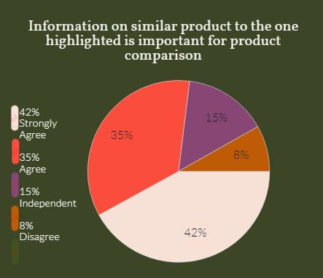
Users openion on online retail shops for different questions
Information on similar product to the one highlighted is important for product comparison
Around 42% strongly agree that information on similar products to the one highlighted is important for product comparision.
Around 35% agree that information on similar products to the one highlighted is important for product comparision.
Around 15% have openion that information on similar products to the one highlighted is important for product comparision is indifferent.
Around 8% disagree that information on similar products to the one highlighted is important for product comparision.

Slide 10
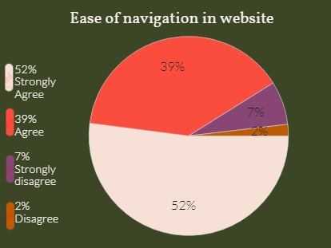
Ease of navigation in website
Around 52% of the user says that they strongly agree that navigation through website is easy.
Around 39% of the user says that they agree with ease of navigation through website Around 7% of the user strongly disagree with the ease of navigation through website Around 2% of the user disagree with the ease of navigation through website
Convenient Payment methods
Around 59% of user strongly agree that the payment methods are convinient
Around 29% of user agree that the payment methods are convinient
Around 12% of user disagree that the payment methods are convinient

Slide 11
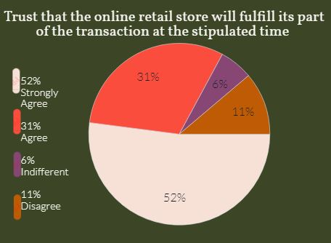
Trust that the online retail store will fulfill its part of the transaction at the stipulated time
Around 52% of user strongly agree that they have trust in the online retail store will fulfill its part of the transaction at the stipulated time
Around 31% of user agree that they have trust in the online retail store will fulfill its part of the transaction at the stipulated time
Around 11% of the user disagree with the fact that online reatail store will fulfill its part of the transaction at the stipulated time.
Around 6% of user stated that its indifferent.

Slide 12
Empathy (readiness to assist with queries) towards the customers
Around 71% of user strongly agree with the fact that the online retail stores are always ready to assist with querries of customers.
Around 15% of user agree with the fact that the online retail stores are always ready to assist with querries of customers.
Around 8% of user disagree with the fact that the online retail stores are always ready to assist with querries of customers.
Around 6% of user stated that this is indifferent.
Return and replacement policy of the e-tailer is important for purchase decision Around 74% of user strongly agree that replacement policy is important for purchase
Around 19% of user agree that replacement policy is important for purchase
Around 7% of user disagree with the fact that replacement policy is important for purchase
Shopping online is convenient and flexible
Around 54% of user strongly agree that online shopping is flexible and convinient
Around 29% of user agree that online shopping is flexible and convinient
Around 5% of user disagree that online shopping is flexible and convinient Around 12% of user stated it as indifferent

Slide 13
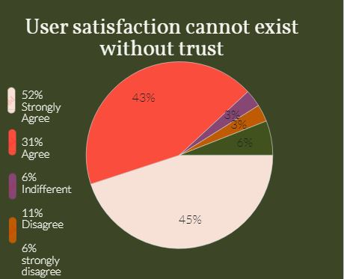
User satisfaction cannot exist without trust
Around 45% of user strongly agree that user satisfaction cannot exist without trust
Around 43% of user agree that user satisfaction cannot exist without trust
Around 6% of user strongly disagree that user satisfaction cannot exist without trust
Around 3% of user disagree that user satisfaction cannot exist without trust
Around 3% of user stated it as indifferent

Slide 14
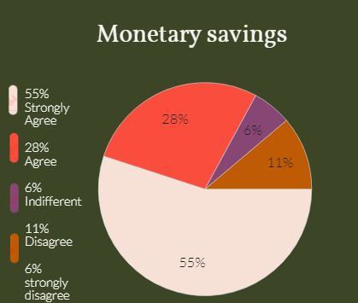
Monetary savings
Around 55% of user strongly agree with the fact that there is a monetary savings through online shopping
Around 28% of user agree with the fact that there is a monetary savings through online shopping
Around 11% of user disagree with the fact that there is a monetary savings through online shopping
Around 6% of user stated it as indifferent

Slide 15
Getting value for money spent
Around 15% of users stated it as indifferent
Around 55% agree the fact that they got the value for money spent
Around 30% strongly agree the fact that they got the value for money spent
Users choice web application on different areas
Which is the easy to use application?
According to user the Amazon, Flipkart and paytm are top three easy to use applications.
Amazon
flipkart
paytm
Which is the most reliable web application?
According to user amazon tops the chart followed by flipkart and paytm
amazon
flipkart
paytm

Slide 16
Which web application takes most care regarding the privacy of customer’s information?
In case of customers privacy amazon tops the chart followed by flipkart and paytm
Limited mode of payment on most products (promotion, sales period)
In case of limited mode of payment on most of the products snapdeal tops the chart followed by flipkart and amazon.
Which website has longer delivery period?
In case of longer delivery period snapdeal tops the chart followed by paytm and flipkart.
paytm
snapdeal
flipkart
Which website declares price of products in late?
In case of late declaration of price myntra tops the chart followed by paytm and flipkart
Myntra
paytm
flipkart

Slide 17
Availability of several payment options?
According the user amazon has got several payment options followed by flipkart and myntra.
Amazon
flipkart
Myntra
Which website provides the complete relevent description of the products?
According to user amazon tops the chart in providing the complete relevent product description followed by flipkart, snapdeal and paytm.

Slide 18
Thank You!!!!

